Slide 1
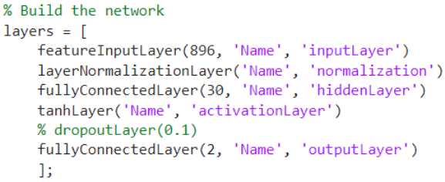
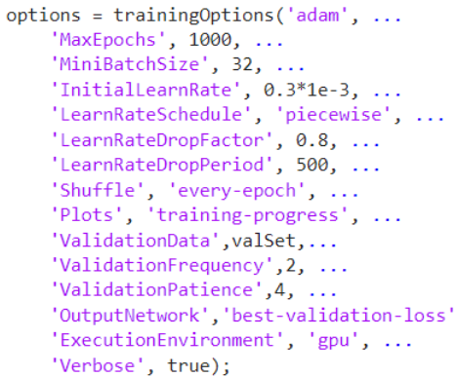
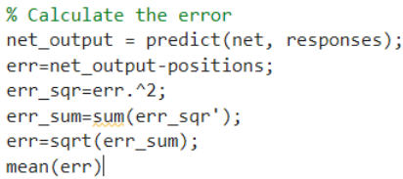
Network structure: MATLAB default normalization layer and one hidden layer.
Random split the data, 90% for training, 10% for validation
The prediction would be better if we can have more data. I changed the split ratio, the more for training, the higher the accuracy is.
The more neurons, the easier the network get overfit. 30 is the best with an additional dropout layer.
Force | Homogen | Grid | Radial | Part radial
0.3N | 8.2647/7.9909 | 7.1712/7.2680 | 3.8118/3.5888 | 4.0848/4.0045
0.5N | 7.6443/7.2763 | 6.0729/6.1957 | 4.8500/4.3977 | 4.9457/5.1696
0.7N | 7.2480/7.4773 | 5.2670/5.3860 | 4.0827/4.2389 | 5.4774/5.7126
We calculated the mean error (the root sum square of difference between prediction and ground truth) two times for each pattern.
The radial and part radial patterns have lower error than the others
For the grid pattern, the error decrease with the increase of the press force.
For the radial pattern, the error has no obvious relationship with the press force.

Slide 2
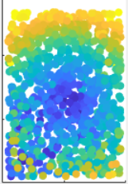
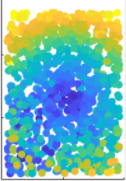
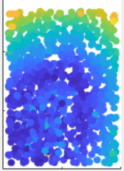
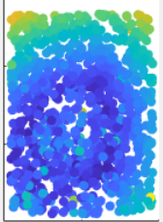

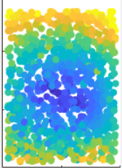
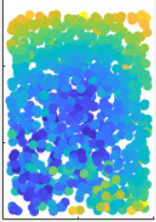
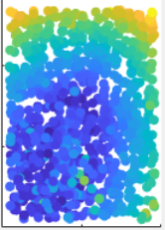
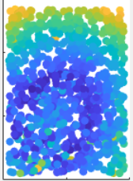
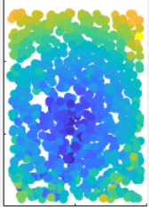
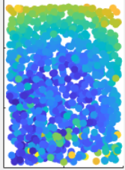
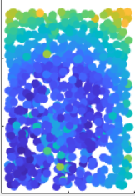
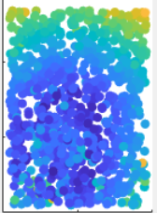
Force | Homogen | Grid | Radial | Part radial
0.3N
0.5N
0.7N
Error map

Slide 3
From the error maps, the high accuracy regions of homogen and grid patterns are mainly in the center of the maps. The high accuracy region of radial pattern is like a circle.
For the further analysis, we may need:
More data, especially for the radial and part radial patterns, because these two patterns have lower error than the others
We need to analyze the influence of the different patterns from the error maps or other measure techniques, need to discuss

Slide 4
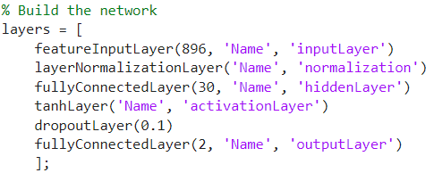
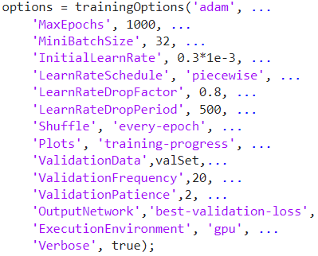
Network structure: MATLAB default normalization layer, one hidden layer and dropout layer
Random split the data, 90% for training, 10% for validation
The prediction would be better if we can have more data. I changed the split ratio, the more for training, the higher the accuracy is.
The more neurons, the easier the network get overfit. 30 is the best with an additional dropout layer.
Force | Homogen Loss | Grid Loss | Radial Loss | Part radial Loss
0.3N | 38.056 | 26.332 | 9.3552 | 9.7749
0.5N | 35.267 | 19.813 | 8.613 | 10.81
0.7N | 31.358 | 16.532 | 9.5312 | 12.949
1.0N | 34.99 (564 data) | 14.878 |  | 22.1 (271 data)

Slide 5
Network structure: MATLAB default normalization layer and one hidden layer.
Random split the data, 90% for training, 10% for validation
The prediction would be better if we can have more data. I changed the split ratio, the more for training, the higher the accuracy is.
The more neurons, the easier the network get overfit. 30 is the best with an additional dropout layer.
Force | Homogen | Grid | Radial | Part radial
0.3N | 42.298 | 39.011/29.572 | 12.476/16.036 | 17.177/16.317
0.5N | 35.856/32.73 | 27.281/28.766 | 18.906/16.544 | 19.682
0.7N | 38.326 | 21.541/21.737 | 14.172/14.959 | 21.018/22.555
Force | Homogen | Grid | Radial | Part radial
0.3N | 8.2647/7.9909 | 7.1712/7.2680 | 3.8118/3.5888 | 4.0848/4.0045
0.5N | 7.6443/7.2763 | 6.0729/6.1957 | 4.8500/4.3977 | 4.9457/5.1696
0.7N | 7.2480/7.4773 | 5.2670/5.3860 | 4.0827/4.2389 | 5.4774/5.7126

Slide 6
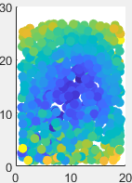
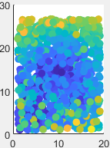
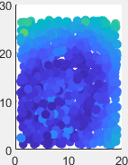
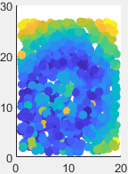
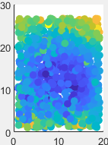
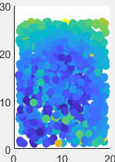
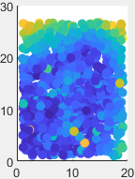
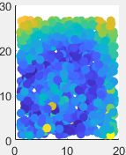
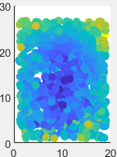
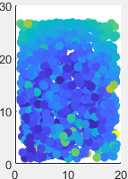
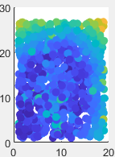
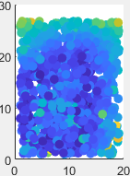
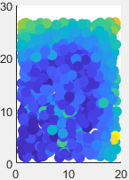
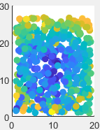
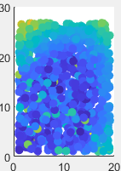
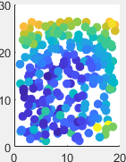
Error map: The error is the root sum square of difference between prediction and ground truth
Force | Homogen | Grid | Radial | Part radial
0.3N
0.5N
0.7N
1.0N

Slide 7
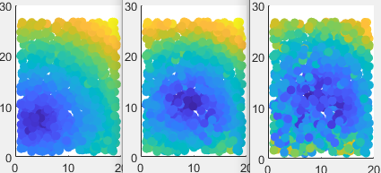
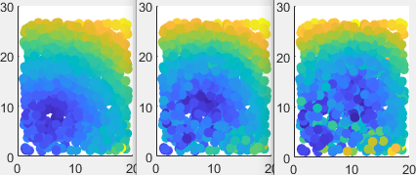
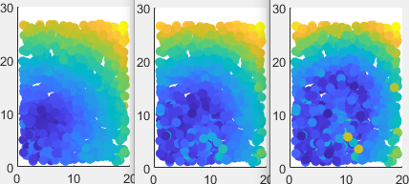
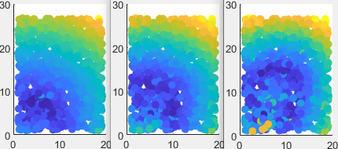
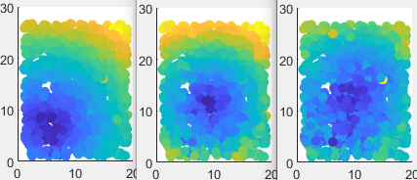
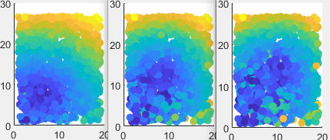
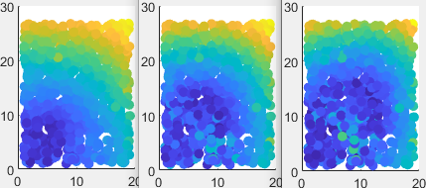
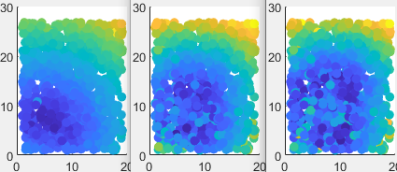
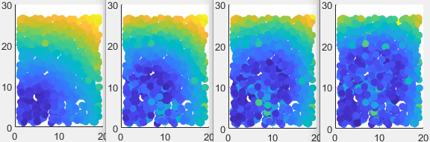
Because the data size might not be enough, and the network might be overfit. We can get some easily predicted region from some not fully-trained network prediction error maps.
Train 10, 30, 50 epochs each
Force | Homogen | Grid | Radial | Part radial
0.5N
0.7N

Slide 8
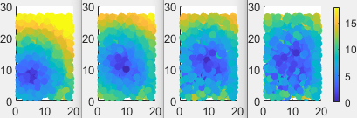
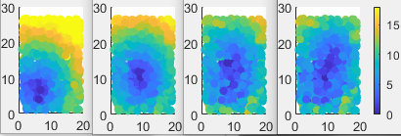
Homogen 05 epochs: 10, 30, 50, 70
Epochs | 0.3N | 0.5N | 0.7N | 1.0N
10
30
50
70 |  |  | 28.11
Homogen 07

Slide 9
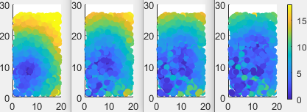
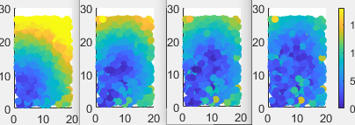
Grid 05 epochs: 10, 30, 50, 70
Epochs | 0.3N | 0.5N | 0.7N | 1.0N
10 |  | 59.764 | 70.147
30 |  | 32.707 | 30.991
50 |  | 30.841 | 21.518
70 |  | 22.339 | 18.944
Grid 07

Slide 10
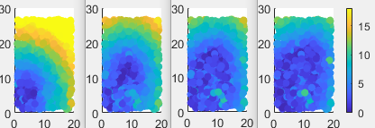
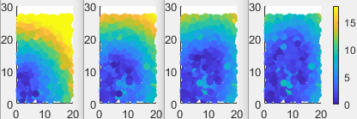
Radial 05 epochs: 10, 30, 50, 70
Epochs | 0.3N | 0.5N | 0.7N | 1.0N
10 |  | 74.119 | 60.267
30 |  | 28.078 | 32.41
50 |  | 19.307 | 16.522
70 |  | 11.975 | 13.357
Radial 07

Slide 11
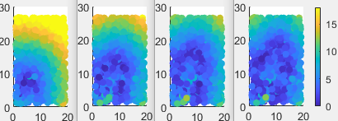
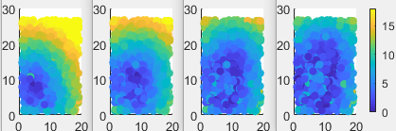
Part Radial 05 epochs: 10, 30, 50, 70
Epochs | 0.3N | 0.5N | 0.7N | 1.0N
10 |  | 75.765 | 68.01
30 |  | 35.607 | 42.536
50 |  | 16.245 | 24.098
70 |  | 17.016 | 17.435
Part Radial 07

